Slide 1
Injury control in public health
Yamin Tauseef Jahangir, MPH(Thailand)
Department of Public Health
Notes:
Dr.Mohammad Hayatun Nabi

Slide 2
Injury: Definition
Injuries are caused by acute exposure to physical agents such as mechanical energy, heat, electricity, chemical, and ionising radiation interacting with the body in amounts or at rates that exceed the threshold of human tolerance.
In some cases (for example, drowning and frostbite), injuries result from sudden lack of essential agents such as oxygen or heat.

Slide 3
Injuries, unintentional or intentional, constitute a major public health problem, killing more than 5 million people worldwide each year and causing many more cases of disability.
People from all economic groups suffer fatal injuries, but death rates due to injury tend to be higher in those in the lower income groups.
The poor are also less likely to make a full recovery following an injury.

Slide 4
Historically, the injury problem has been neglected, largely because injuries were viewed as accidents or random events.
Today, however, injuries are known to be preventable.
The use of seat belts, car seats for children, designated drivers, fencing around water areas, flame-resistant clothing and smoke detectors, together with early childhood education and family counseling to prevent violence have all proved to be effective measures for preventing injuries.

Slide 5
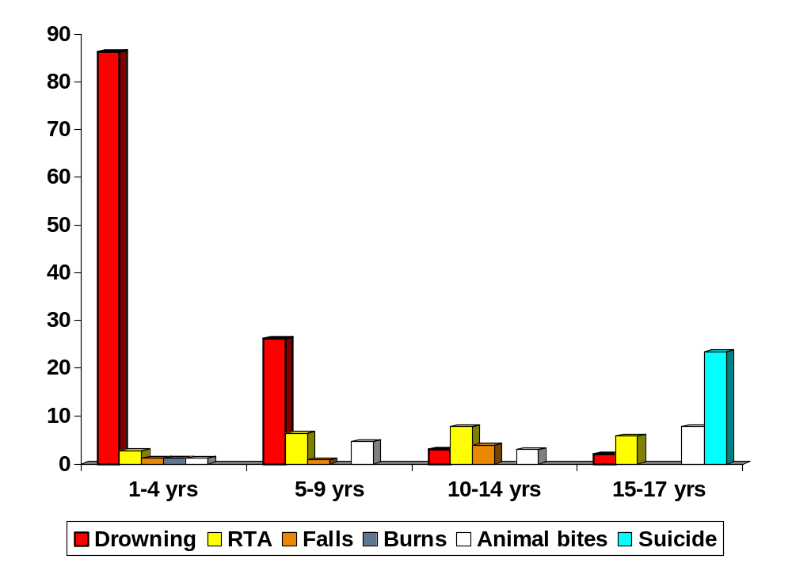
Different injuries in different age
BHIS 2005

Slide 6
Public Health Transition
Pattern of morbidity and mortality is changing
Infectious diseases
Non-Communicable disease and Injuries

Slide 7
Injury is still an unrecognized and neglected health problem in low-income countries
Dr. Mohammad Hayatun Nabi

Slide 8
GAPS IN INJURY PREVENTION
Inaccurate data on the
  Magnitude of the problem
  Risk factors
  Economic consequences
  Evaluation of prevention efforts
Limited awareness of the problem
  Policy makers
  Donors

Slide 9
Why this Data Constraints ?
Vital Registration System is Poor
No Death Registration System
Birth registration system is in infant stage
Inadequate Hospital Information
No organized MIS system

Slide 10
Injury Surveillance
Ongoing and systematic collection, analysis, interpretation and dissemination of health information and application of this information for prevention and control.
Surveillance gives answer of two questions
  What is the problem ?
  What is the cause ?

Slide 11
Benefits of Surveillance
To convince Policy makers and donors
  -for setting priority
  -to allocate funds
2.Design and apply appropriate interventions
3.Monitor the results and assess the impacts of intervention
4.To initiate more research Capacity building

Slide 12
STEPS REQUIRED FOR SURVEILLANCE
Defining the Problem
Collecting the data
Evaluating the surveillance system
Entering the data
Processing /analysis the data
Using the results to plan prevention
Interpreting the data
Reporting the result

Slide 13
ATTRIBUTES OF A SURVEILLANCE SYSTEM
Simplicity: The system should produce all the data needed, but in the most simple and straightforward way possible.
Flexibility: The system should easy to change.
Acceptability: The system will only work if people are willing to participate in it.
Reliability: Any one using the data produced by a surveillance system should have complete confidence on the accuracy of the data

Slide 14
MINIMUM DATA NEED ON INJURY SURVEILLANCE
Age, sex
Place of Injury
Activity during injury
Mechanism of injury
Intent
Specific data for type of injury

Slide 15
THE MOST CRITICAL ISSUE:
Injury always happens in the community
But only sometimes is treated in the hospital or other health facility
Connecting these two is very difficult
Notes:
Dr.Mohammad Hayatun Nabi

Slide 16
DATA SOURCES
For fatal Injuries
  Police records
  Post mortem reports
  Household survey
For severe non fatal injuries
  Hospital inpatients records
For Major and minor injuries
  Household Survey

Slide 17
Establishing injury Surveillance system
    Hospital data: Hospital injury registration system should be developed.
    - data should be collected from admitted patients only
    - hospital staff should be involved in data collection
    Police report and post mortem report: These report should be collected from local police stations record.
    Household Survey: Can be done in every two years.

Slide 18
Model for Injury surveillance at local level in low-income countries like Bangladesh
Post-mortem reports
Police reports
Fatal
Injuries
B
I
AN
N
U
A
L
Severe
Household
Surveys
Hospital injury registration
Moderate
Minor
Estimation of the injury deaths in the area
Post mortem reports, Police reports, and Household surveys
Estimation of injury morbidity in the area
Hospital registry and household surveys

Slide 19
Bangladesh Experience
It is now well established that injury is a leading cause of death and disability among 1-17 year old children in Bangladesh.
The government of Bangladesh and development agencies realize that injury is one of the obstacles to economic development and now is the right time for action.

Slide 20
Historically, the majority of information regarding injury is derived from mortality and hospitalization data.
This information does not reflect the full extent of the injury problem because most people who are injured do not die from their injuries or receive treatment in hospitals.
Adequate data about types of injuries and their causes is vital to understand injury problems.
Community based injury surveillance, while normally difficult to sustain, is a way to more accurately characterize the magnitude of injury problems in middle and low-income countries.

Slide 21


